Slide 1
WAR

Slide 2
War…
“A conflict carried on by force and arms, as between nations or between parties within a nation.”
- Dictionary.com

Slide 3
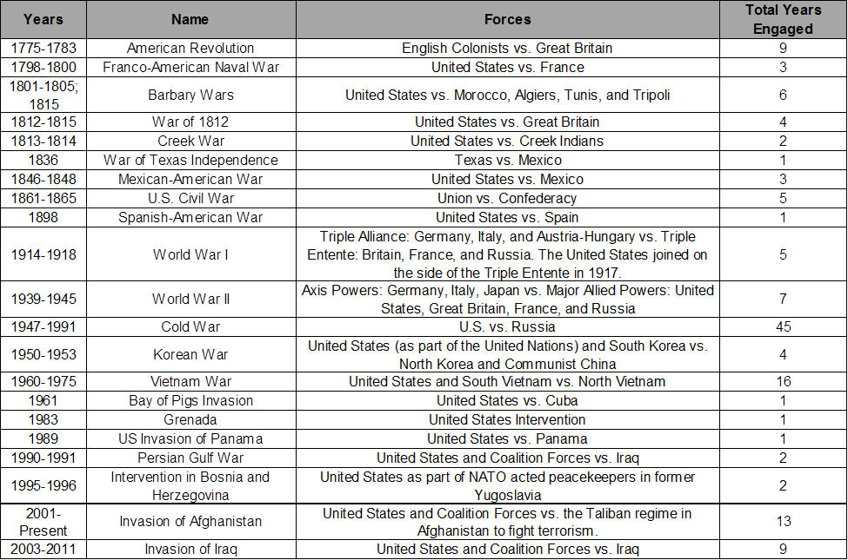
U.S.A. War Timeline

Slide 4
The United States at War
In United States has been in existence for 238 years. In those 238 years:
We have been at war for 103 years (43%)
We have been in combat for 83 years (35%)

Slide 5
Revolutionary War: 1775-1783
In the 1760s, the British began imposing new taxes and limiting freedoms of the colonists in the 13 American colonies. By 1775, the colonists had had enough.
But there were many who were reluctant to go to war against a power like Great Britain. Patrick Henry, a Virginian attorney, politician, and noted orator changed many minds with this passionate speech:

Slide 6
Revolutionary War: 1775-1783
Late in the morning on July 4, 1776, after days of discussion and debate, Thomas Jefferson proposed the Declaration of Independence to the Continental Congress in Independence Hall in Philadelphia, PA. Church bells rang when news of its ratification reached the city.

Slide 7
Revolutionary War: 1775-1783
Began: April 19, 1775, when British troops were ordered to Lexington and Concord to seize stores of gunpowder and capture Samuel Adams and John Hancock.
Fighting Ended: October 17, 1781, when the British surrendered to the Americans and the French after a brutal defeat at Yorktown.
War Ended: September 3, 1783, when the Treaty of Paris was signed.
Results: Britain recognizes American independence and cedes Florida and Minorca to Spain.
Casualties: Approximately 10,500

Slide 8
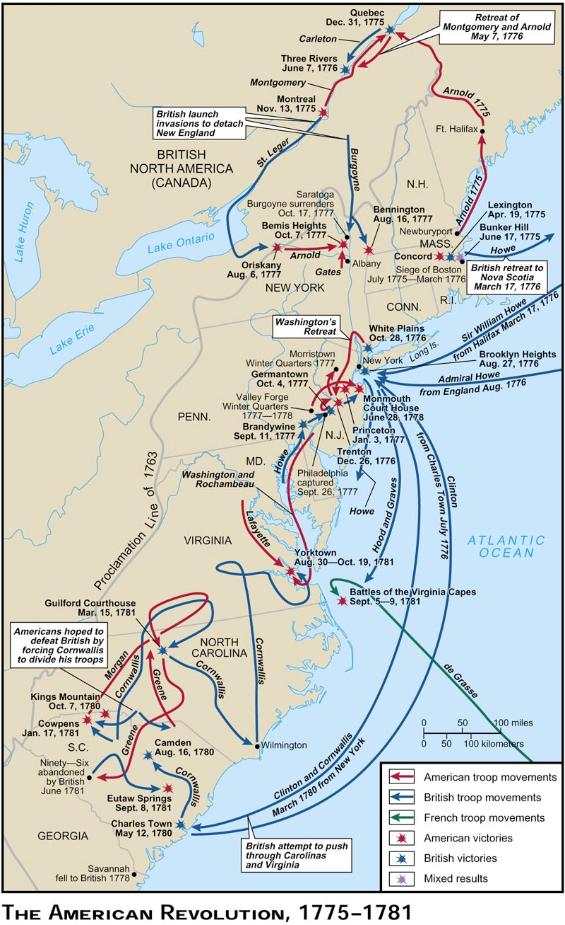
Revolutionary War
Battles
and
Troop Movements

Slide 9
J.R.R. Tolkien:
“War must be, while we defend our lives against a destroyer who would devour all; but I do not love the bright sword for its sharpness, nor the arrow for its swiftness, nor the warrior for his glory. I love only that which they defend.”

Slide 10
War of 1812: 1812 - 1815
Just 30 years after the Revolutionary War, the U.S. found themselves again going to war with Great Britain
U.S. angry about trade issues, impressment of sailors, and British support for Native American aggression
U.S. invaded Canada
Britain invaded the South and aligned with Native American forces
Neither side gained any ground; war ended in a stalemate
War further solidified U.S. nationalism
Casualties: Approximately 13,000

Slide 11
President Herbert Hoover:
“Old men declare war. But it is the youth that must fight and die.”

Slide 12
Mexican American War: 1846-48
In 1836, Texas fought and won a battle for independence against Mexico. However, the border continued to be disputed, and Mexico never formally acknowledged Texas independence.
In 1845, Texas as annexed and admitted to the Union as the 28th state. The U.S. inherited the border dispute with Mexico.
In 1846, the U.S. occupied New Mexico and California and invaded Northern Mexico. We took control of the Pacific coast and then marched on and took Mexico City, ending the war.
The Treaty of Guadalupe Hidalgo ceded territory in New Mexico, Arizona, Colorado, Utah, Nevada and California to the United States.
Casualties: Approximately 15,000

Slide 13
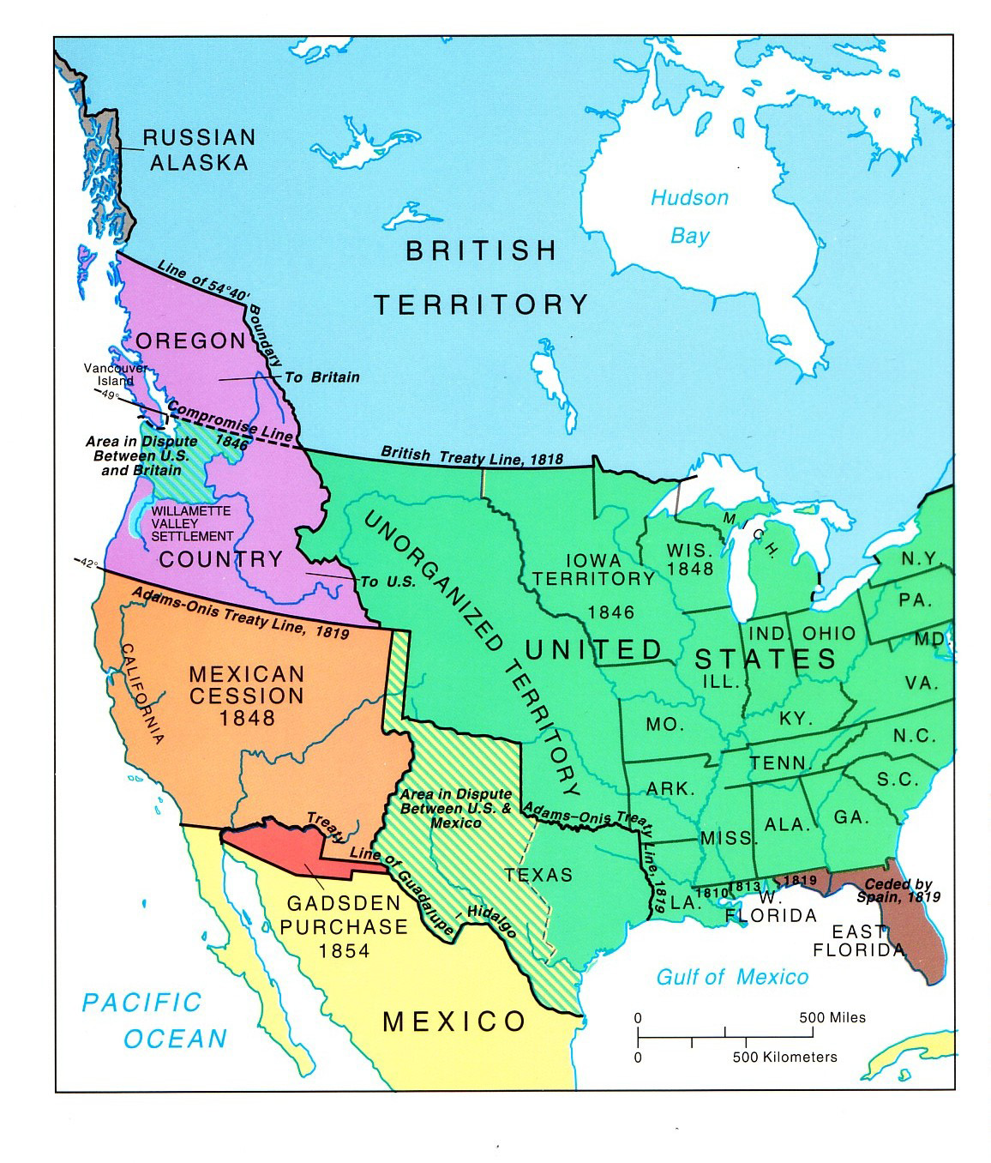
Territory gained by U.S. as a result of the Mexican-American War

Slide 14
Bertrand Russell:
“War does not determine who is right – only who is left.”

Slide 15
Civil War: 1861-1865
After Abraham Lincoln was elected President, the South seceded from the Union and formed the Confederate States of America
In April 1861, shots rang out at Fort Sumter South Carolina and the fighting began.
July 1-3, 1863 saw the largest battle in the Civil War in Gettysburg, PA. 160,000 men fought that day. Casualties were over 50,000 men.
In November 1863, Pres. Lincoln was invited to the Gettysburg battle site to dedicate a National Cemetery. He was not the featured speaker, but his speech is the one we still remember.

Slide 16
Fact Sheet: Civil War: 1861-1865
Dates: April 12, 1861 – April 9, 1865
End: Robert E. Lee surrendered to Ulysses S. Grant at Appomattox Courthouse in Appomattox, Virginia
First Battle: Battle of Fort Sumter (in S.C.)
Last Battle: Palmito Ranch (Texas, fought after surrender was declared)
Union Army: 2,128,948
Confederate Army: 1,082,119
Combined Casualties: 620,000 – 850,000 (23%)

Slide 17
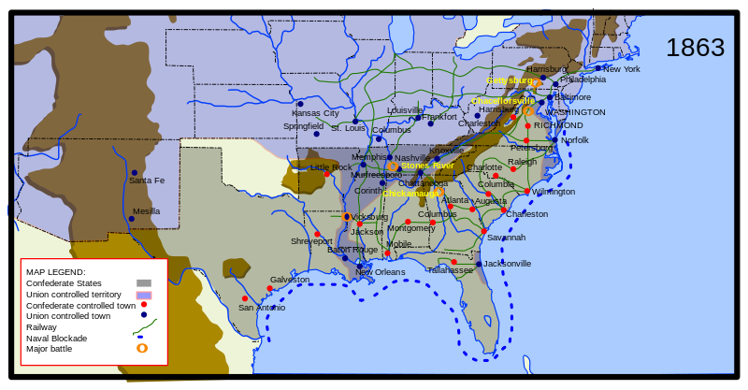
Civil War Map

Slide 18
President Jimmy Carter:
“War may sometimes be a necessary evil. But no matter how necessary, it is always an evil, never a good. We will not learn how to live together in peace by killing each other’s children.”

Slide 19
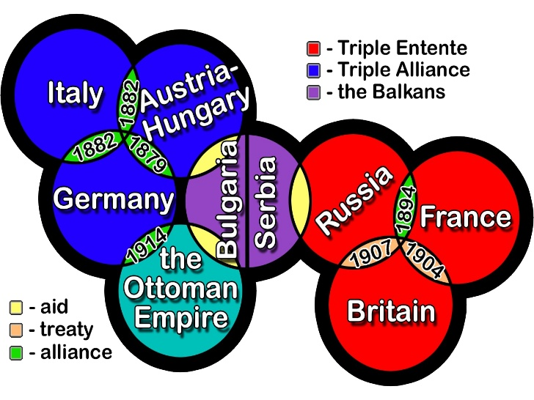
World War I: 1914-1918
Setting the stage:

Slide 20
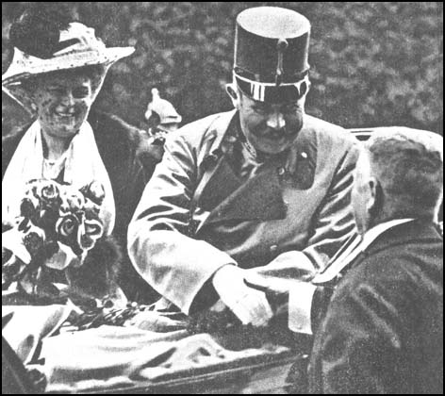
World War I: 1914-1918
In June 1914, Archduke Ferdinand of Austria and his wife were assassinated by a Serbian nationalist in Bosnia, setting in motion a series of dominos. Once all the dominoes had fallen, World War I had begun.

Slide 21
World War I Domino Effect

Slide 22
Domino Effect Continued…

Slide 23
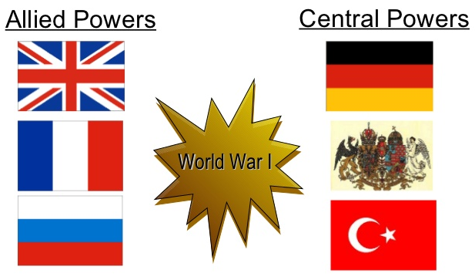
World War I Sides
Britain
Germany
France
Austria-Hungary
Russia
Ottoman Empire

Slide 24
World War I: U.S. Involvement
On May 8, 1915, the Lusitania, a British supply ship bound from London from New York City was sunk by a German submarine. 1195 people (128 Americans) were killed.
The Germans continued relentless submarine warfare, interrupting U.S. trade and supplies bound for the Allies forces.
Additional economic, political, and ideological reasons, along with an intercepted telegram prompted President Woodrow Wilson requested Congress declare war against Germany on April 6, 1917.

Slide 25
World War I Weapons
Machine Gun
Chemical Weapons (Poison Gas)
Submarines
Airplanes
Tanks
Where did all these new weapons come from?

Slide 26
World War I: How did it end?
Trench warfare and new weapons led to a stalemate. Neither side could make a decisive move to win.
Millions died without gaining any ground.

Slide 27
World War I: Casualties
Total troops mobilized: 65,038,810
Total troops missing or POWs: 7,750,945
Total troops wounded: 21,219,452
Total troops killed: 8,556,315

Slide 28
World War I: Results
Germany surrendered.
Allies impose the Treaty of Versailles
Declares Germany guilty of starting the war
Requires Germany to pay reparations to Allies
This sets the stage for World War II
League of Nations was formed as a diplomatic body to help prevent war in the future. This is the precursor to the United Nations.

Slide 29
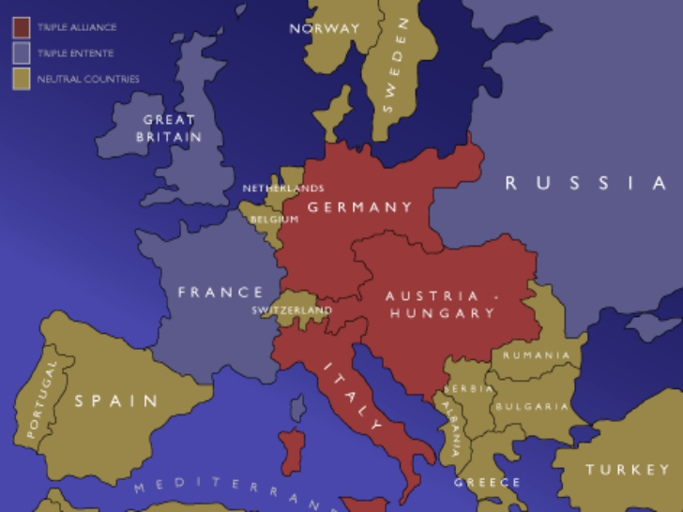
World War I: Europe Before

Slide 30
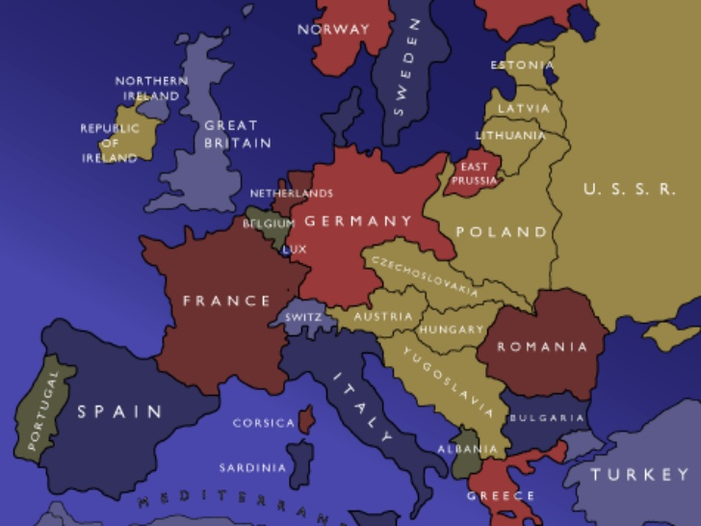
World War I: Europe After

Slide 31
Thomas Mann
“War is only a cowardly escape from the problems of peace.”

Slide 32
Malcolm X:
“Sometimes you have to pick up a gun to put the Gun down.”

Slide 33
G.K. Chesterton
“The true soldier fights not because he hates what is in front of him, but because he loves what is behind him.”

Slide 34
Jean-Paul Sartre:
“When the rich wage war it’s the poor who die.”

