Slide 1
Policy Debate
Informative, Persuasive, and Impromptu Speaking all rolled into one!

Slide 2
Resolution
The topic of and foundation for the debate
For example:
Resolved:
The United States Federal Government should substantially increase its engagement with China on one or more of the following issues: space debris, climate change, the Trans-Pacific Partnership, and/or Taiwan.

Slide 3
Affirmative & Negative
AFFIRMATIVE
NEGATIVE
Support the Resolution
Make a Case for Change
Come up with a Plan
Burden of Proof
Denounce the Resolution
Support the Status Quo
Poke Holes in Aff Plan
Burden of Clash

Slide 4
The Affirmative
They support, or agree with, the resolution.
They say the status quo is not good enough, so they make a case for change
The entire Affirmative argument is built around Stock Issues
Part of the case for change is to come up with a Plan, which addresses the stock issues

Slide 5
Aff Case & Aff Plan
The Affirmative Case is proving that something needs to change within the status quo.
The Affirmative Plan is Affirmative’s plan for solving the status quo’s problems they pointed out in their case.

Slide 6
Affirmative Stock Issues
Significance: This is a big deal, and the Aff plan makes a big change
Harms: Bad things are happening in the status quo and they are only going to get worse if we don’t do something.
Inherency: The problems aren’t currently being solved.
Topicality: We are talking about what the resolution specifies.
Solvency: We solve for the aspects of the resolution addressed in our case and plan.

Slide 7
Organizing the Aff
Aff Case
Case for Change
Aff Plan
The Change
Harms
If we continue with the SQ, bad things will happen
Topicality
We are talking about what the resolution specifies
Solvency
Our plan solves the harms
Inherency
The problems aren’t being solved and won’t be solved unless we act
Significance
This is a big problem, and we make a big change

Slide 8
The Negative
Disagree with the Resolution
Make a case for the Status Quo: Everything is fine the way it is!
Poke holes in the Aff

Slide 9
Negative Arguments
The Neg can challenge the Aff in any way they choose. These arguments are divided into On Case and Off Case arguments.
On Case Arguments: Things that tie to Aff Case/Plan
Harms
Inherency
Solvency
Significance
Off Case Arguments: Things that don’t tie to Aff Case/Plan
Topicality
Critique
Disadvantages (DisAds)
Counter Plan

Slide 10
Neg On-Case Arguments
Harms (H): Aff will say the status quo has bad things in it
Neg can argue that that status quo doesn’t have bad things
Neg can argue that SQ’s “bad things” aren’t as bad as AFF wants us to believe
Inherency (I): Aff will say that harms aren’t being and won’t be fixed unless they act
Neg can argue that harms are being addressed in the SQ
Neg can argue that harms will fix themselves, without doing anything
Solvency (S): Aff will say that their plan solves their harms
Neg can argue that Aff plan doesn’t solve harms
Neg can argue that Aff plan not specific enough
Significance (Sig): If Aff doesn’t prove that resolution is a big deal, or if they don’t make a significant change in their Plan, Neg should use it.

Slide 11
Neg Off-Case Arguments
Topicality (T): Aff must stay within the bounds of the resolution. If they don’t Neg can argue it.
Critique (K): Neg can argue that Aff is biased due to some kind of mindset or assumption, and that bias should be grounds for rejection of Aff claims or plan
Disadvantages (DisAds or DAs): Neg can illustrate that bad things will happen if the Aff Plan is adopted. If Neg DisAds are stronger than Aff Harms, Neg will win.
Counter Plan (CP): Neg can reject the status quo in favor of introducing their own plan as an alternate to the Aff Plan.

Slide 12
Logistics: Round Structure
Constructive Speeches
1AC: 5 min
1NC: 5 min
2AC: 5 min
2NC: 5 min
New arguments can only be introduced during constructive speeches.
Rebuttal Speeches
1NR: 2 min
1AR: 2 min
2NR: 3 min
2AR: 3 min
Each side gets 5 minutes of prep time, to use whenever they want.

Slide 13
Logistics: Rules
Both sides have the same amount of time
Affirmative speaks first and last
Negative has the Neg Block
No new arguments can be introduced during rebuttals
Affirmative has the burden of proof
Negative has the burden of clash

Slide 14
Evidence
Evidence includes: Statistics, expert quotations/opinions, and research studies
Cite Sources: Every source, every time you use it
Opposing side can ask for your evidence on a point, and you must be able to produce it. If you can’t, it becomes a voting issue (and a grading issue). Inability to produce evidence on request is the debate version of cheating.
Evidence is not an argument in itself. It is only used to support the arguments you come up with.
New evidence can be used during rebuttals to counter an attack from the other side, or to bolster up one of your arguments.

Slide 15
Organization
Signpost Your Speeches
“Our first harm is…”
“Our plan consists of three components. First…”
“The affirmative has two main problems with their plan. First…”
Take notes according to the signposting

Slide 16
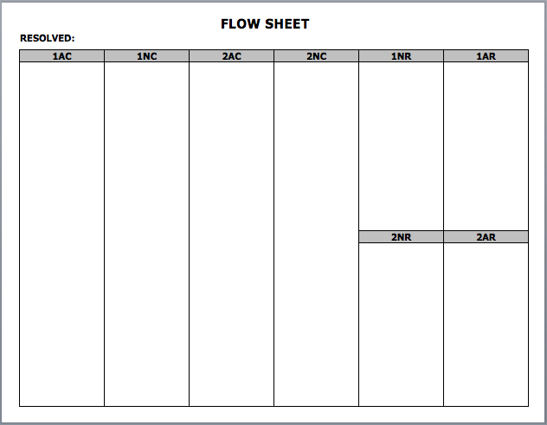
The Flow
How to take notes during a policy debate

Slide 17
