Slide 1
Latin America
The Good and the Bad

Slide 2
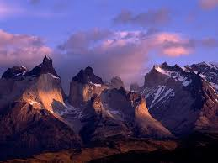
Andes Mountains

Slide 3
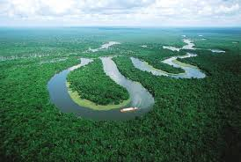
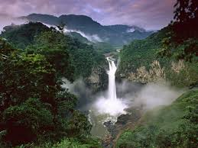
Amazon River

Slide 4
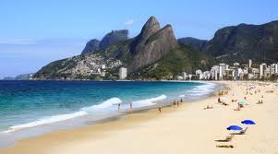
Beaches: Brazil

Slide 5
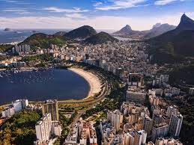
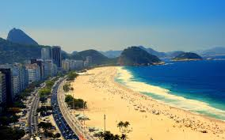
Beaches: Rio de Janeiro, Brazil

Slide 6
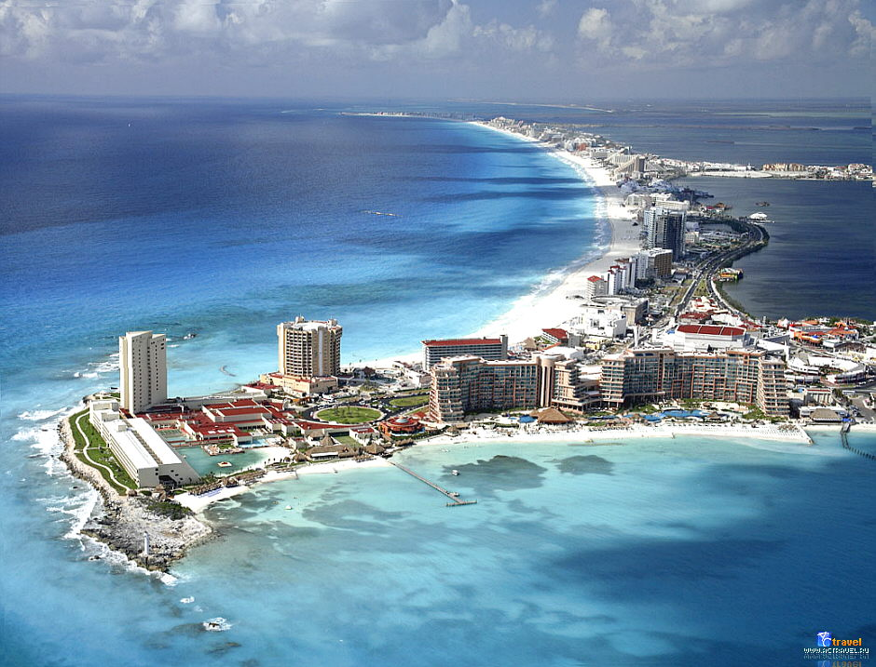
Resorts: Yucatan Peninsula

Slide 7
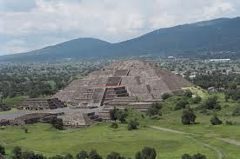
Aztec Ruins: Mexico

Slide 8
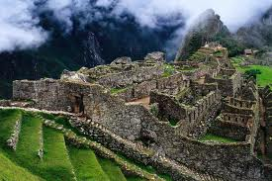
Incan Ruins: Macchu Piccu, Peru

Slide 9
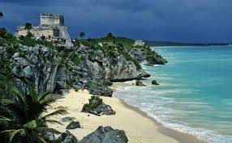
Yucatan Peninsula: Mayan Ruins

Slide 10
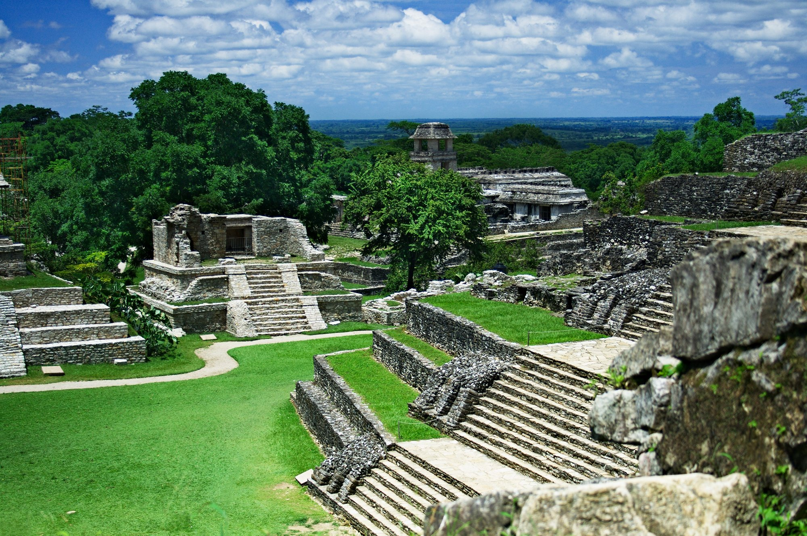
Mayan Ruins: Mexico

Slide 11
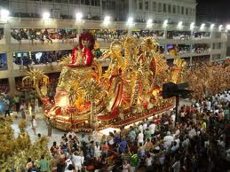
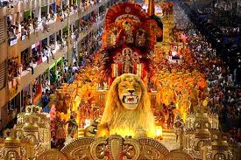
Carnival: Rio do Janeiro, Brazil

Slide 12
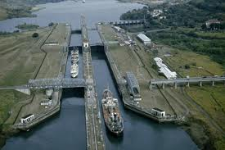
Panama Canal

Slide 13
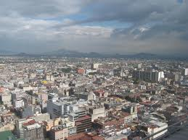
Urban Sprawl: Mexico City

Slide 14
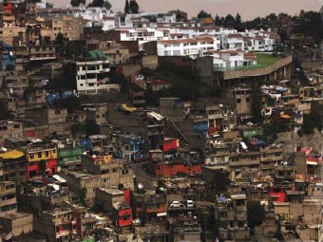
Shanty Town: Mexico City

Slide 15
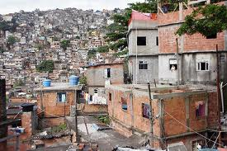
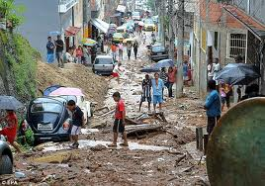
Shanty Town: Rio de Janeiro, Brazil

Slide 16
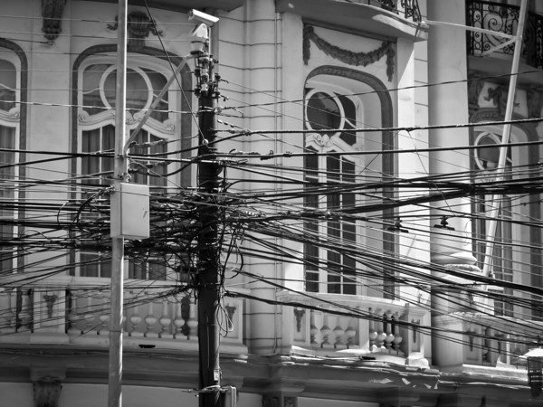
Electrical Issues: Chile

Slide 17
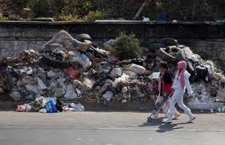
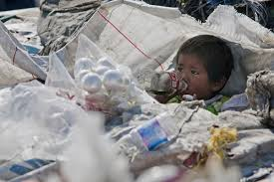
Garbage: Mexico City

Slide 18
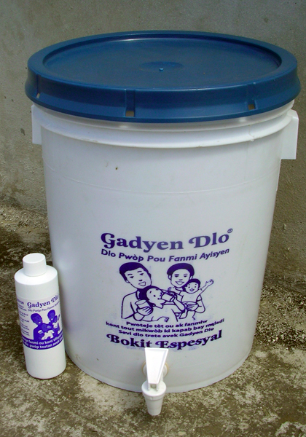
Clean Drinking Water

Slide 19
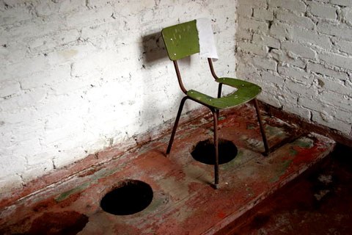
Sanitation Issues: Brazil

