Slide 1
Water and Oil
In the Middle East

Slide 2
Water
The most scarce and most valuable resource in the Middle East is water. If you control the water, you control life.

Slide 3
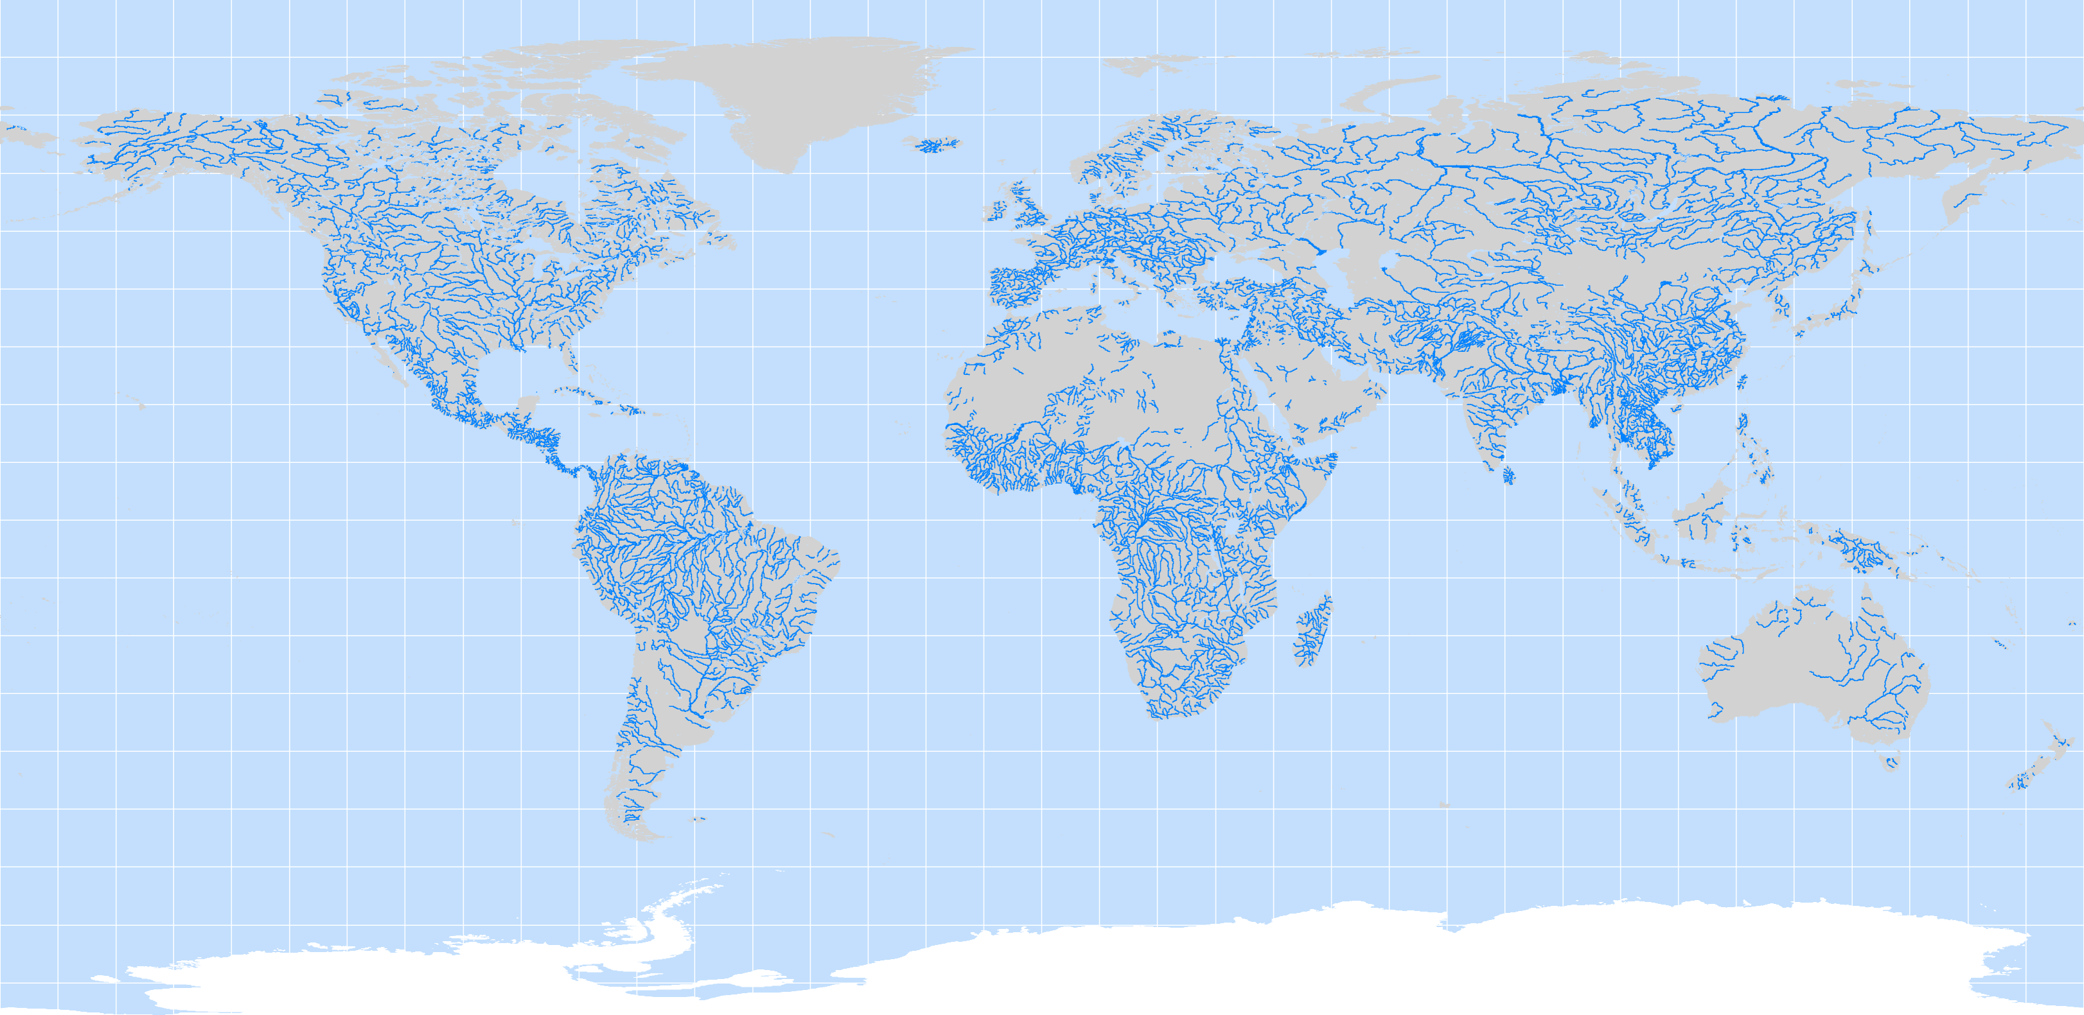
Rivers

Slide 4
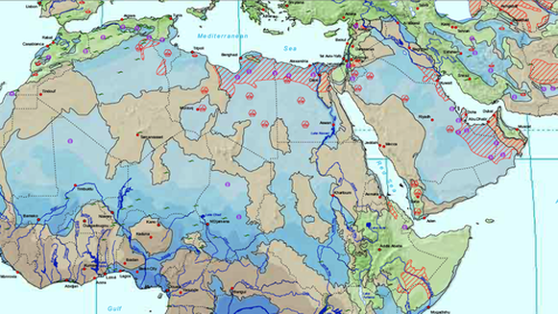
Aquifers
A freshwater, underground lake. (Graphic p. 471)

Slide 5
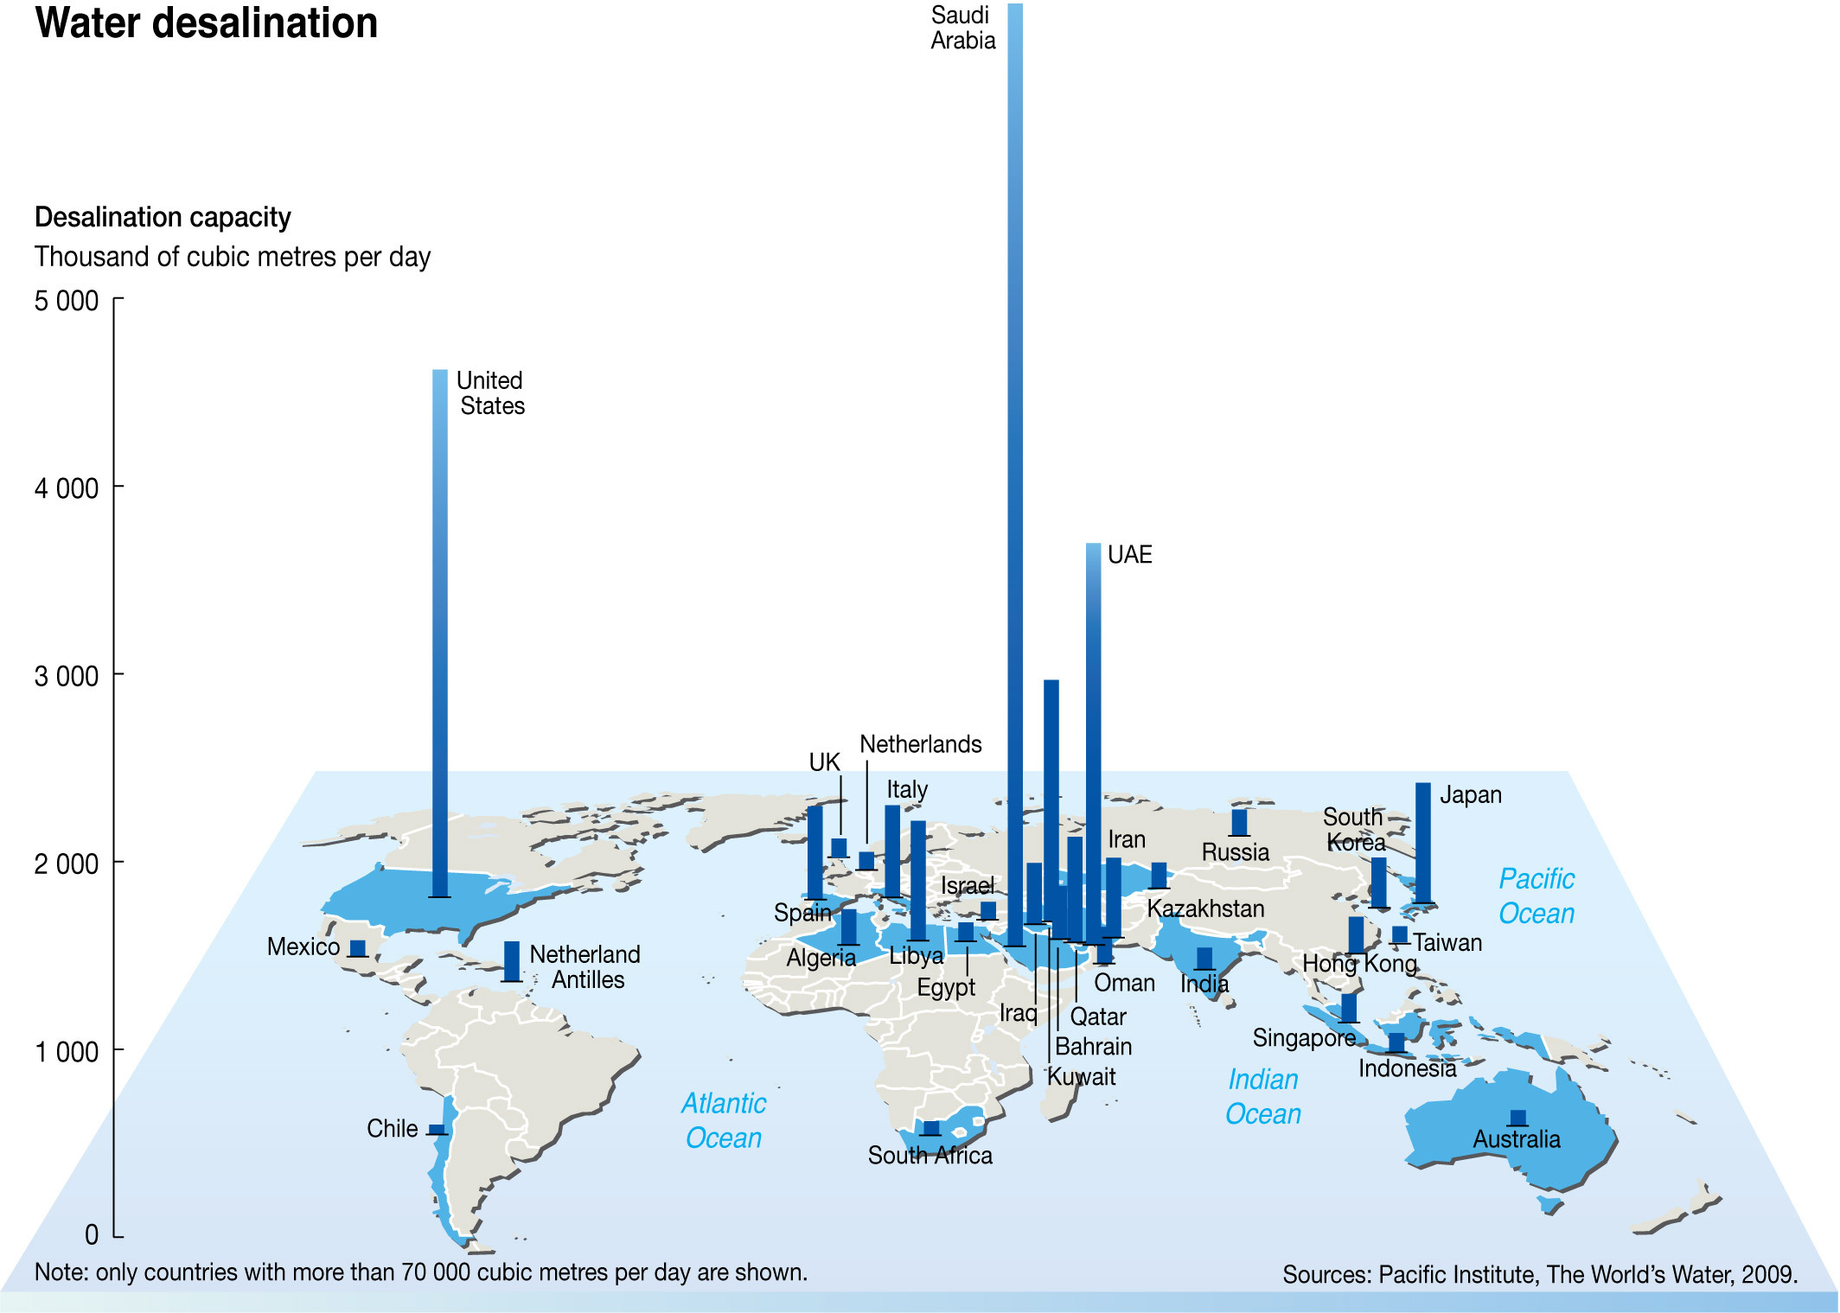
Desalination
The process of removing salt from saltwater to create freshwater. (Graphic p. 471)

Slide 6
Water Fight: Graded Discussion
Future wars in the Middle East could very well be fought over water.
Why might that be?
Who might be the combatants?
How do borders influence the issue of water availability and the control of rivers?

Slide 7
My Response
The Middle East, by and large, is a desert. Freshwater resources are very limited and the average annual rainfall is less than 25 centimeters per year. However, there are major rivers, including the Nile, Euphrates, and Tigris that flow through certain countries in the region, providing water for crop irrigation and other necessities of life. Within these lucky countries, dependence on these rivers is almost total. Outside of these countries, water is scarce, and the need is great. In all likelihood, wars over water would be started by those who do not have access to it or control over it fighting against those who do. In this sense, an arbitrary political border, and what is or is not contained within that border, could very well determine two sides in a war.

Slide 8
Oil
Black gold that has brought unimagined riches to Persian Gulf nations.

Slide 9
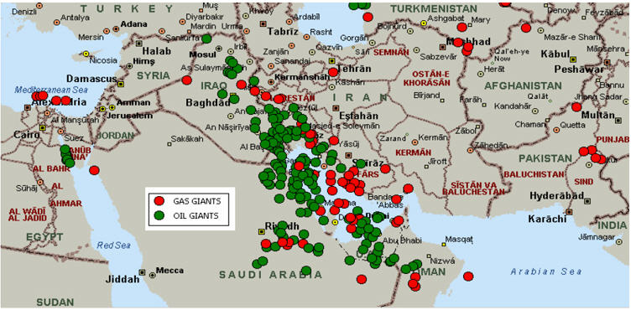
Oil/Gas Fields in the Region

Slide 10
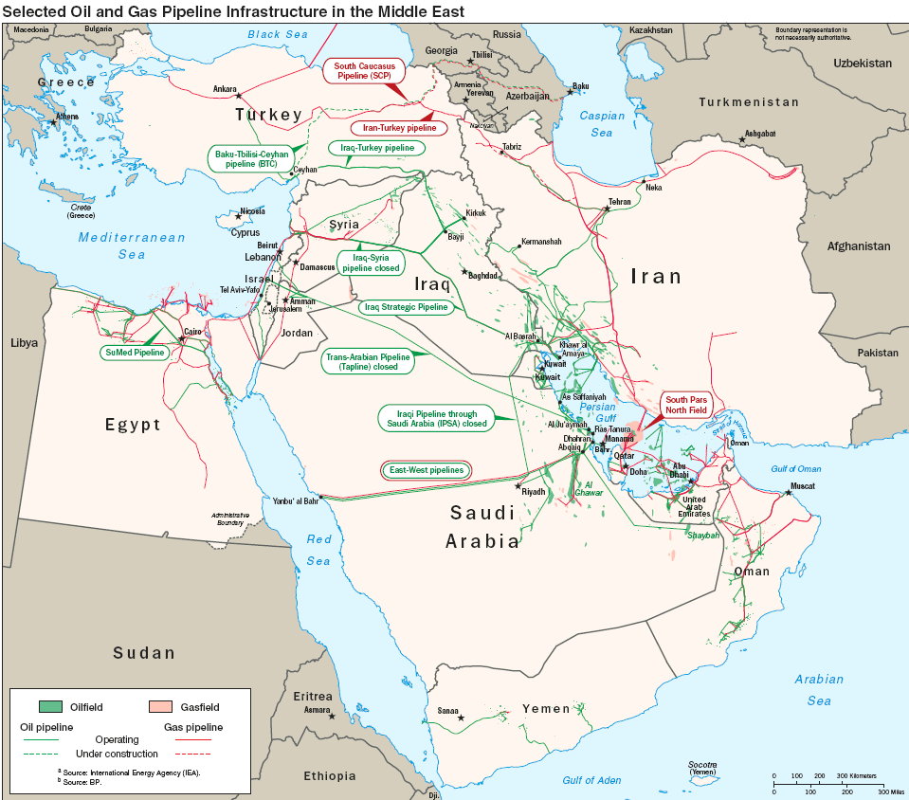
Oil to Market

Slide 11
Pros and Cons of Oil
Read article on pages 444-445 in your text.
What are the benefits to oil discovery and export?
What are the pitfalls facing Persian Gulf countries due to oil?

Slide 12
Oil Simulation
It is February 2017. As the beginning of the summer travel season in the United States looms, President Trump has managed to frustrate our allies in the Middle East. Despite the efforts of the United States to help broker a peace accord, the Israeli-Palestinian conflict is continuing. A group of Middle Eastern countries, including some of the OPEC member states, is threatening to place an embargo on the oil to the United States in order to voice its members’ discontent with America’s ongoing financial support for Israel and President Trump’s cozy relationship with Israeli Prime Minister Benjamin Netanyahu. This could result in the price of a barrel of oil quadrupling—costs that would be passed on to American consumers, with everything from increased prices at the gas pump to higher priced airline tickets and home heating oil. Gas could top $6/gallon, plummeting the US back into a recession, or even depression.

Slide 13
What should we do?
Continue support for Israel and risk an oil shortage?
Find alternative sources of energy?
Negotiate with the Middle East?
Some compilation of options?

