Slide 1
INDIA
And South Asia

Slide 2
Topography
India is a subcontinent, which is a large, distinct landmass that is attached to a continent
During the break-up of Pangaea, the Indian Plate ran into the Asian Plate, creating the Himalaya Mtns. at a convergent fault (where two plates crash into each other)
Divergent Fault: Where two plates spread apart from each other
Transverse/Transform/Strike-Slip Fault: Where two plates slide past each other going opposite ways
Between the Ghats lies a triangle of rugged hills known as the Deccan Plateau. It was once covered with lava, but today has rich, black soil. However, it doesn’t get enough rain, so the area is extremely dry.

Slide 3
Water
The Ganges River flows east from the Himalaya. It floods during monsoon season, depositing an alluvial plain of very fertile soil used for farming.
The Ganges Plain is the most densely populated area of India.

Slide 4
Climate (Pg. 576)
Land of many climates
Tropical: Rainforest and Savanna
Dry: Steppe and Desert
Humid Subtropical
Highlands, where elevation plays a role
Three seasons, dependent on seasonal monsoonal winds
Hot
Wet
Cool
Monsoons: Winds bring different phenomena, either cool and dry or humid and wet

Slide 5
Population
Parts of South Asia are VERY densely populated (clip)
Most densely populated area in the region is along the Ganges Plain
Megacity: Mumbai, population 18+ million
Megalopolis: Chain of closely linked cities
Urbanization: A growing problem in South Asia’s cities
The majority of the population in the region live in rural areas

Slide 6
Culture
They speak 19 separate languages in the region, plus many dialects.
Hindi is most dominant
English is also widely spoken, remaining from British colonial days
Three major religions: Hinduism, Buddhism, and Islam (clip)
Hinduism
Consider cows sacred
Followers must carry out his/her dharma, or moral duty. Believe in karma, or good deeds, move us toward or away from eternal life.
Believe in reincarnation, always striving to overcome weaknesses
Achieve reunion with the eternal being
Other religions in the region include: Islam, Buddhism, and Sikhism
“Bollywood:” Thriving dance and film industry centered in Mumbai (2 clips)

Slide 7
History
Indus River Valley Civilization
2500 B.C
Aryans
1500 B.C.
Mauryan Empire
320 – 180 B.C.
Very Advanced: Writing system, centralized government, overseas trading, plumbing & sanitation systems
Hunters and Herders: Settled down and began to farm. Left behind sacred writings called the Vedas. Developed a caste system.
Promoted Buddhism and nonviolence

Slide 8
History Continued
Gupta Empire
320 – 550 A.D.
Muslims
700 – 1100 A.D.
Europeans
1500 – 1947 A.D.
Very advanced Hindu empire. Science, technology and the arts flourished. Most likely developed Arabic writing.
Missionaries and traders arrived in 700 A.D. Muslim empires dominated the region for many centuries and many Indians converted to Islam.
Portuguese, French, and British invaders arrived in the 1500s. By the 1700s, British had complete control. They introduced English, restructured education, built railroads, and developed a civil service. British influence is still felt.

Slide 9
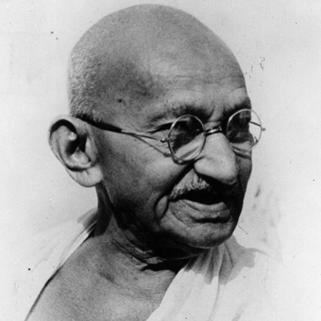
Indian Independence
The British officers in India were notorious for being disrespectful and harsh.
The movement for independence was led by Mohandas Gandhi.
He was a Hindu
He studied law at the College of London
He advocated nonviolent civil disobedience (peaceful protests, hunger fasts, boycotting of British goods, marches, etc)
After serving time in prison for his demonstrations, he was named Mahatma, meaning “Great Soul”
Was instrumental in negotiating a peaceful independence for India from British rule

Slide 10
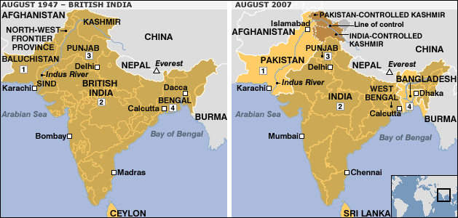
Before and After

Slide 11
After Independence
Shuffling and Unrest
Boundaries: Hindu majority areas became India and Muslim majority areas became Pakistan. India was in the middle and Pakistan was separated on the east and west.
Families: With the new borders, Hindu families living in the new Pakistan moved to India and Muslim families living in the new India moved to Pakistan.
In 1971, East Pakistan revolted against West Pakistan and became the new country of Bangladesh.
Religious violence often erupted between the two groups.
In 1948, while Gandhi was working for peace as a mediator for the two sides, he was assassinated by a Hindu nationalist.
Regional religious conflicts still occur, especially along the borders.

Slide 12
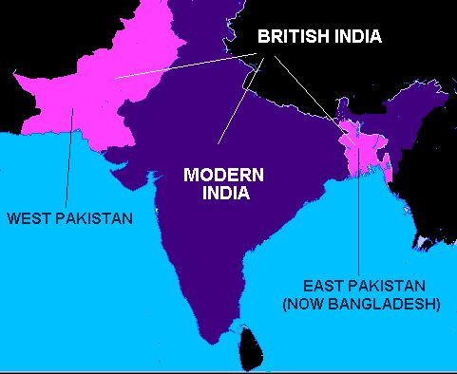
Border Shuffle

Slide 13
The Region Today
India is a “democracy”
Actually, a federal parliamentary republic
Because ethnic and religious conflicts led to many assassinations, and the government is only partially effective
Pakistan is a “democracy”
Actually, a parliamentary republic
Military rule and instability have dominated the political landscape since 1971
Sri Lanka and Bangladesh are also “democracies”
Actually, parliamentary republics
Political and ethnic rivalries have caused much instability
Overall, countries in this region are on the right track, striving for democracy, but still encountering obstacles toward true and full liberty for the people.

