Slide 1
Cultural Geography of the Middle East
People, History, and Religion

Slide 2
The PEOPLE
Of the Middle East

Slide 3
Arabs
Most people of this region, about 275 million, are Arabs
Most Arabs are Muslims and follow the religion of Islam
A small percentage of Arabs are Christian, or follow a religion different than Islam
Most Arabs speak Arabic
Originally, Arabs lived on the Arabian Peninsula and a few areas to its north.
Because of the spread of Islam, Arabs are now dominant groups in 16 different countries and many Arabic-speaking people are descendants from a different ethnic group than Arabs, such as Egyptians and Phoenicians

Slide 4
Israelis
About 6.4 million people in this region are Israeli
Israelis live in Israel
About 82% of Israelis are Jewish. The remaining 18% of Israelis are mostly Arabs who are either Muslim or Christian.
Most Israelis speak Hebrew.
Many Jews living in Israel can trace their heritage to the ancient Israelites, who believed God had given them the Land of Canaan (present day Israel and Lebanon) as a permanent homeland. In 1948, Israel was established as a Jewish state.
Arabs in the region, however, did not want a Jewish state established, as the region had been their homeland for centuries. This caused tension between the two groups that still exists today and is often violent.

Slide 5
Other Groups
Turks: They live in Turkey on the Anatolia Peninsula. Turks were the founders of the Ottoman Empire, which ruled must of the eastern Mediterranean world for 600+ years. Most Turks are Muslim and speak Turkic. There are also other Turkic peoples, living in Central Asia in the –stans.
Iranians: Iran was once called Persia. 66.6 million people live there. They speak Farsi and most are Shi’ite Muslims. They believe they are descended from the Aryans, Indo-Europeans who migrated to the region from Southern Russia in 1000 B.C.
Afghans: Afghanistan is a melting pot of different ethnic groups and cultural tribes. They speak many different languages, but most practice Islam.
Caucasians: There are many different groups that inhabit the Caucasus area. Armenians and Georgians are among the largest groups. Most are Christian.
Kurds: They live in the border areas of Turkey, Iran, Iraq, Syria, and the Caucasus in an area unofficially called Kurdistan. They have repeatedly tried to self-rule and establish their own country, but have been repeatedly crushed, often violently, by the Turkic and Arab rulers.

Slide 6
The History
Of the Middle East

Slide 7
Mesopotamia & the Sumerians
Mesopotamia
Means Land Between Two Rivers. The two rivers are the Tigris and the Euphrates in present day Iraq. Was called the Fertile Crescent.
Referred to as a culture hearth
The Sumerians lived there
Master farmers, grew crops year round using irrigation canals. Established 12 cities with a code of law. Developed written language of cuneiform.

Slide 8
The Egyptians
Built along Nile River in Egypt. Annual floods left rich soil for good farming. In dry seasons, they used irrigation to water crops, so farmers could grow two crops per year.
Developed a 365-day calendar and built impressive pyramids as tombs for rulers.
The Egyptians
Developed a form of picture writing called hieroglyphics.

Slide 9
The Phoenicians
Phoenicians: Developed along eastern Mediterranean coast
Developed an alphabet in which letters stood for sounds
Basis for many alphabets used in the Western world today

Slide 10
The Persian Empire
500s B.C.
Huge empire from Nile River to Aegean Sea in the west all the way to Amu Darya in Central Asia in the east.
Irrigation Advances
Worried that water could evaporate in open canals, they constructed a series of qanats, or underground canals, to carry water from mountains, across deserts, to farmlands.

Slide 11
The Mongols
Nomads
Today, just like they have for centuries, nomads travel across the land seeking grasslands for their herds
Mongols were a group of nomads who invaded this land
Mongols
In the late 1100s, the famous Mongol leader, Genghis Khan united the nomadic Mongol tribes living north of China.
In the late 1200s, they invaded Central Asia, establishing a vast empire
Outcome
The Mongols killed tens of thousands of people in order to gain control.
Despite their brutality, they brought many improvements to the region, including paper money and safer trade routes.

Slide 12
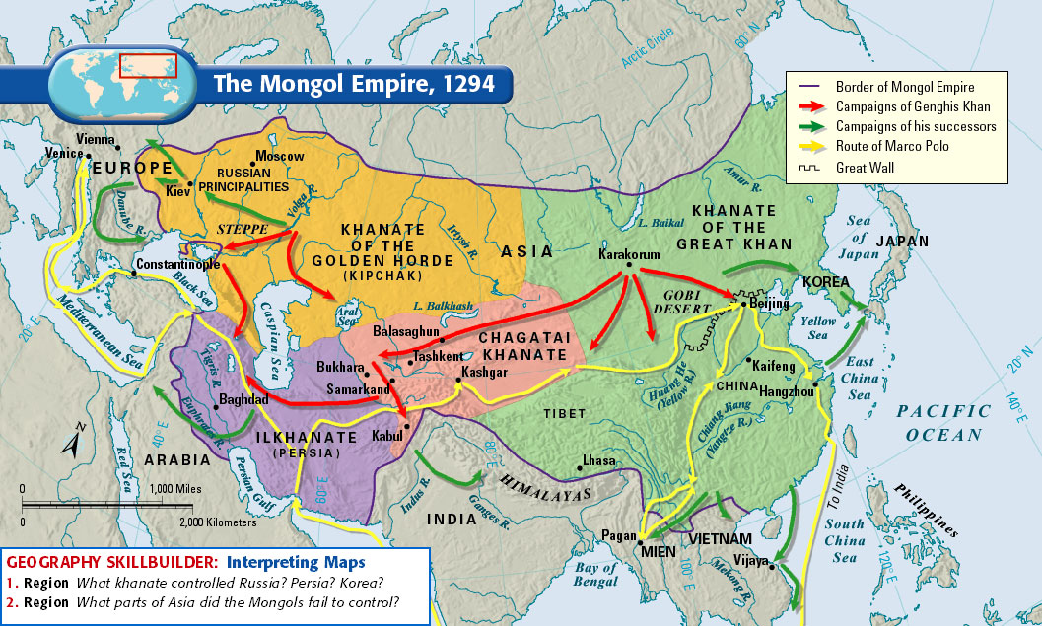
The Mongol Empire

Slide 13
REligions
Of the Middle East

Slide 14
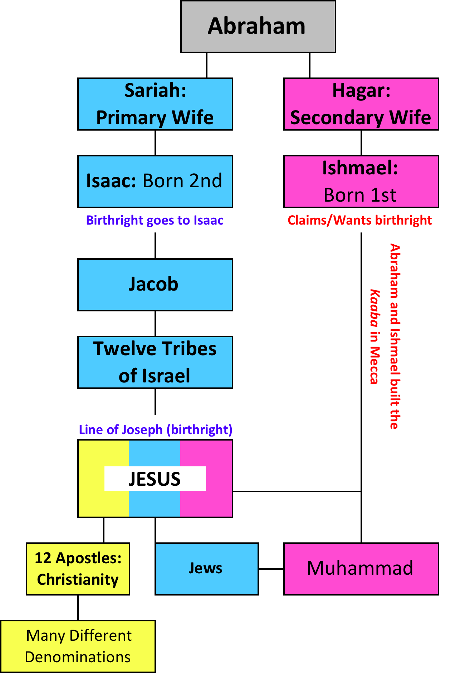
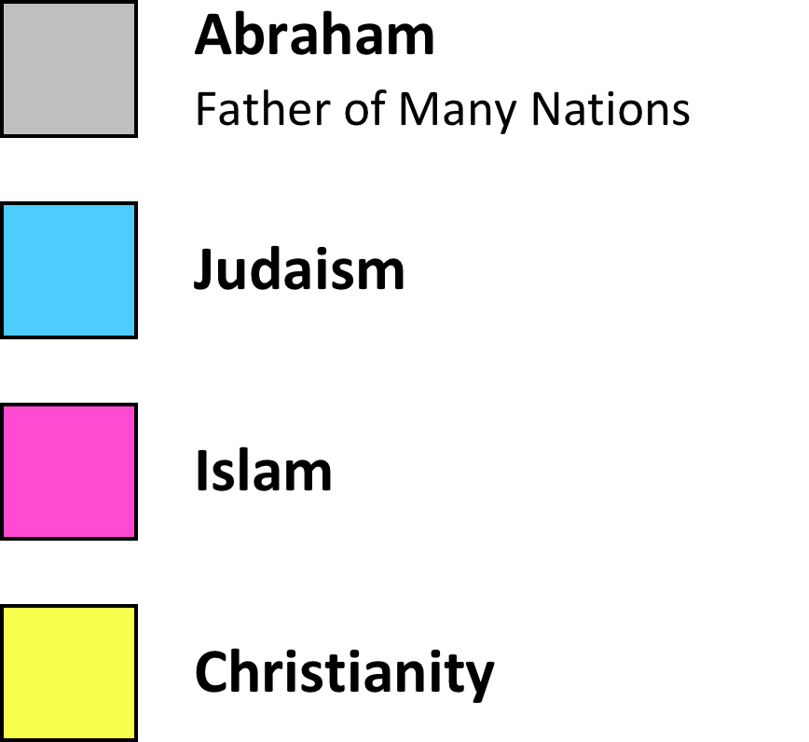
The Origin

Slide 15
Judaism
The oldest monotheistic faith
Present day Jews trace their origins to the ancient Israelites, who set up the kingdom of Israel on the eastern shores of the Mediterranean and made Jerusalem their capital
Historically, Jews enduring political division, conquest, and even exile to Mesopotamia. Although many Jews eventually left Mesopotamia to return to their homeland, many remained scattered.
Judaism teaches observance of God’s laws and the creation of a just society. Jews belief that all events have a divine purpose, which is why they record their history.
Scripture includes the Torah, or Hebrew Bible (Old Testament)
Worship services are head in a synagogue and are officiated by a rabbi.

Slide 16
Christianity
In Israel around A.D. 30, a Jewish teacher named Jesus began preaching a message of renewal and God’s mercy
Many of Jesus’s teachings were unpopular with those in power, and eventually, the Roman rulers of the area put him to death.
Jesus’s followers proclaimed that He was the Savior and Son of God and those who followed Jesus’s teachings would receive salvation in heaven.
Scriptures include the Hebrew Bible as the Old Testament and the teachings of Jesus and early Christians as the New Testament of the Christian Bible.

Slide 17
Islam
The religion is called Islam. The followers are called Muslims.
Major religion of the Middle East.
In A.D. 610, revelations from God came to Muhammad, who was a merchant in the city of Mecca. He was considered the last in a line of prophets that included Abraham and Jesus.
Muhammad started preaching that people should turn away from sin and worship the one, true God.
Islam has had a profound impact on the religious, political, and cultural practices of the region.
Muslims worship in a mosque and their scripture is the Quran, which is a record of Muhammad’s teachings.

Slide 18
Five Pillars of Islam
Faithful Muslims are expected to achieve the Five Pillars of Islam, which are:
Professing faith in God (Allah) and the prophet Muhammad
Praying five times per day
Helping the poor and needy
Fasting during the ninth month of the Islamic calendar (Ramadan)
Making a pilgrimage to Mecca, Islam’s holiest city

Slide 19
CONFLICT
How people and religion ignite conflict

